Slide 1

Angular’s Component Router
Alain Chautard

Slide 2
Angular Component Router
Angular was designed for Single Page Applications
But very often we need more than one page!
The Component Router allows us to emulate this by loading components based on URLs
See the example here: https://goo.gl/y2NGwl
Notes:
Any complex app will need to have several views. Instead of navigating to a new page, which would require a reload of your application, the component router allows to switch between different views easily.
Each view is a component.

Slide 3
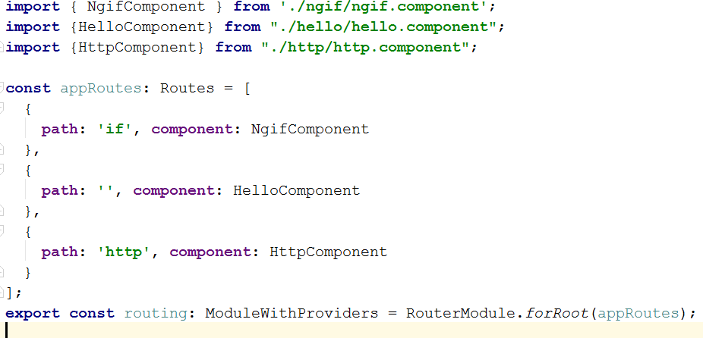
Angular Component Router
It requires a routing table which maps a URL to a component (app.routing.ts):

Slide 4
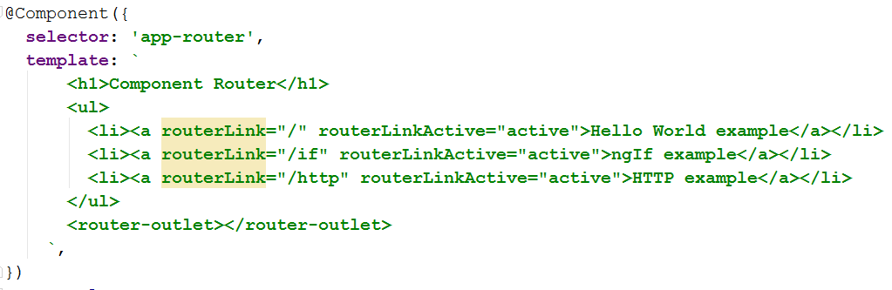
Angular Component Router
<router-outlet> is the place where the components are loaded in the HTML template:
Notes:
Note the syntax for router links so that it’s possible to make an HTML link to a specific route.

Slide 5
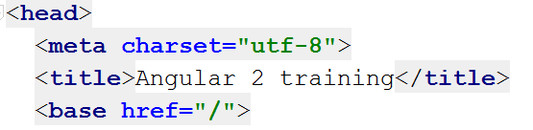
Angular Component Router
It also requires to add a base tag to your index.html page:
The reason for this is to indicate which portion of the URL is managed by Angular, and which one is managed by the server (this also requires some server config)
Notes:
In the above example, this means that your app is basically deployed at the root of its domain, for instance www.gmail.com.
If your app is deployed in a “subfolder”, like www.mydomain.com/myapp, then you need to specify <base href=”/app”> in index.html
It is also important to configure your server so that any URL that is relative to myapp actually returns myapp/index.html, so that the browser will load the Angular app which will then handle its part of the URL and load the right component.
For instance, if a user types in their browser www.mydomain.com/myapp/profile, the server should actually return www.mydomain.com/myapp/index.html, and your Angular application would have a route definition that maps a component to /profile.

Slide 6
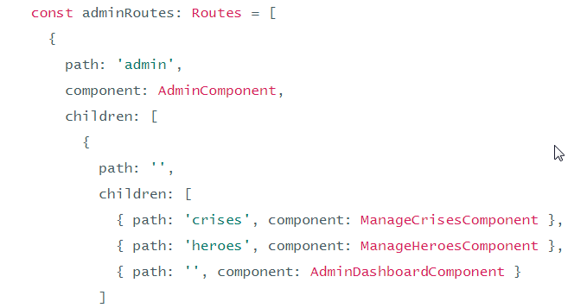
Child Routes
It is possible to define child routes as follows:
In the above example, the AdminComponent template must have a router-outlet to display its children
Notes:
In that case, /admin/crises displays ManageCrisesComponent as a child of AdminComponent, while /admin displays AdminDashboardComponent as a child of AdminComponent.

Slide 7

Passing Parameters to Child Routes
Parameters have to be named in the router config:
In the above example, the id can be retrieved in TypeScript by injecting the ActivatedRoute service and accessing its params array of properties:
Notes:
As a result, in the above example, if the URL is hero/21 , ActivatedRoute.params[‘id’] would be equal to 21.
Navigating to that URL programmatically in TypeScript could be achieved with: this.router.navigate(['/heroes', { id: 21 }]);

Slide 8
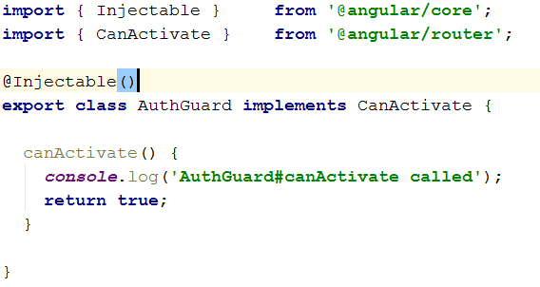
Guards for Authentication
Prevent routes from being accessed using a guard:
A guard implements a canActivate method and simply returns true if the route is allowed, false otherwise:

Slide 9
Component Router Wrap-up
<router-outlet> is the placeholder where the actual component is loaded
You can define child routes as well
Guards allow to fine tune authentication and user rights
The router always evolves a lot. Keeping an eye on https://angular.io/docs/ts/latest/guide/router.html is a good practice
Notes:
As a matter of fact, the component router has already been through a couple of rewritings before Angular was officially released.

Slide 10
THE END
Thanks for your attention
Alain Chautard - Angular Consultant / Trainer / Mentor
alain@interstate21.com

